Slide 1

Group 1 presentation & Proposal MIS 6380.501 - Data Visualization - F24
GROUP PARTICIPANTS
Deepmala Srivastava
Suman Anand
Rishabh Balaiwar
Mounika Kolle
Naveena Paleti
Gowtham Siddegowda
Group -1 Covid 19, Chicago
Jan 2020-dec 2022

Slide 2

Group 1 Coronavirus disease (COVID-19) pandemic,Chicago Jan2020 to dec 2022 Hypothesis
1. Hypothesis
In the city of Chicago, from January 2020 to December 2022. The relatively low hospitalization (54.38%) and death rate (6.95%) among 4.26 million COVID-19 It is because the cases rate has been dropped by December 2022 hence the low hospitalization resultant low death rate.
2. Hypothesis
In the city of Chicago COVID-19 dataset spanning January 2021 to December 2021. Individuals aged 18-29 showed the highest testing rates (26.26%)88.14k, with a statistically significant peak on Mondays, as this age group has the largest population total of 9,22,516 out of total tested people 3,72,049 hence the age 18-29 shows the highest testing rate.
3. Hypothesis
In the city of Chicago COVID-19 vaccination data from Jan 2021 to December 2022. December 2022 recorded the highest number of doses administered, with a total of 3.91 million doses (2.06 million first doses and 1.86 million second doses) because in December 2022 alone has the highest cumulative total of 171 million out of 3.91M individuals tested hence we see the Highest peak.

Slide 3


Group 1 Coronavirus disease (COVID-19) pandemic,Chicago Jan2020 to dec 2022 Hypothesis
4. Hypothesis
In the city of Chicago COVID-19 data from January 2020 to December 2022, White non-Latinx individuals have the highest average rate of booster doses, with an average of 30,756 boosted individuals, compared to other racial groups because total tested population of 565,589,745 with 950,919,90 individuals identified as White non-Latinx, resulting in the highest average among racial demographics.
5. Hypothesis
In the city Chicago COVID-19 data from January 2021 to December 20, The North/Central region shows the highest average for first-dose vaccinations in the year 2021-2022 specifically in October, November and December because total population in all region is 368,317,460 and out of that the north central has the highest first dose vaccine received 839,728,75 hence the highest average among all.

Slide 4
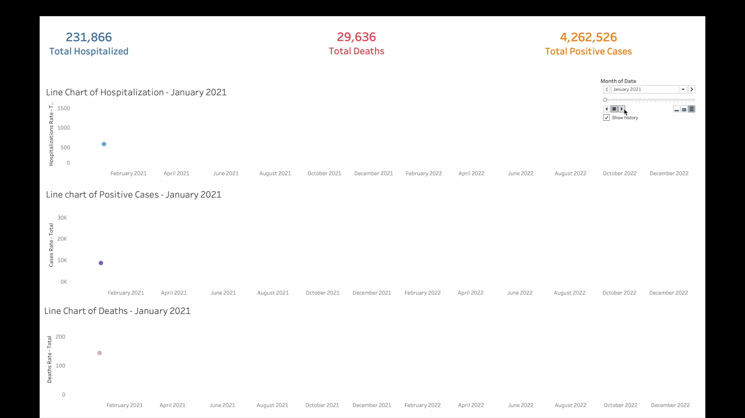
Group 1 Coronavirus disease (COVID-19) pandemic,Chicago Jan2020 to dec 2022 Hypothesis 1
Lower positive case's resulting in decline in hospitalization (54.38%) & death rate (6.95%).

Slide 5
Group 1 Coronavirus disease (COVID-19) pandemic,Chicago Jan2020 to dec 2022
Hypothesis 1 Insights
Total Counts December 2021 shows significant counts across all categories, with positive cases, hospitalizations, and deaths each reaching notable totals.
Patterned Correlation: The data reveals a strong correlation among positive cases, hospitalizations, and deaths, even though they follow a staggered pattern.
Lagged Sequence: The peak in positive cases is followed by a delayed rise in hospitalizations and, subsequently, deaths, illustrating the typical progression and impact timeline of the outbreak on healthcare and mortality.
Conclusion: COVID-19 positive cases are strongly correlated with subsequent hospitalizations and deaths, with a clear lag in each step, reflecting the impact timeline on healthcare.

Slide 6
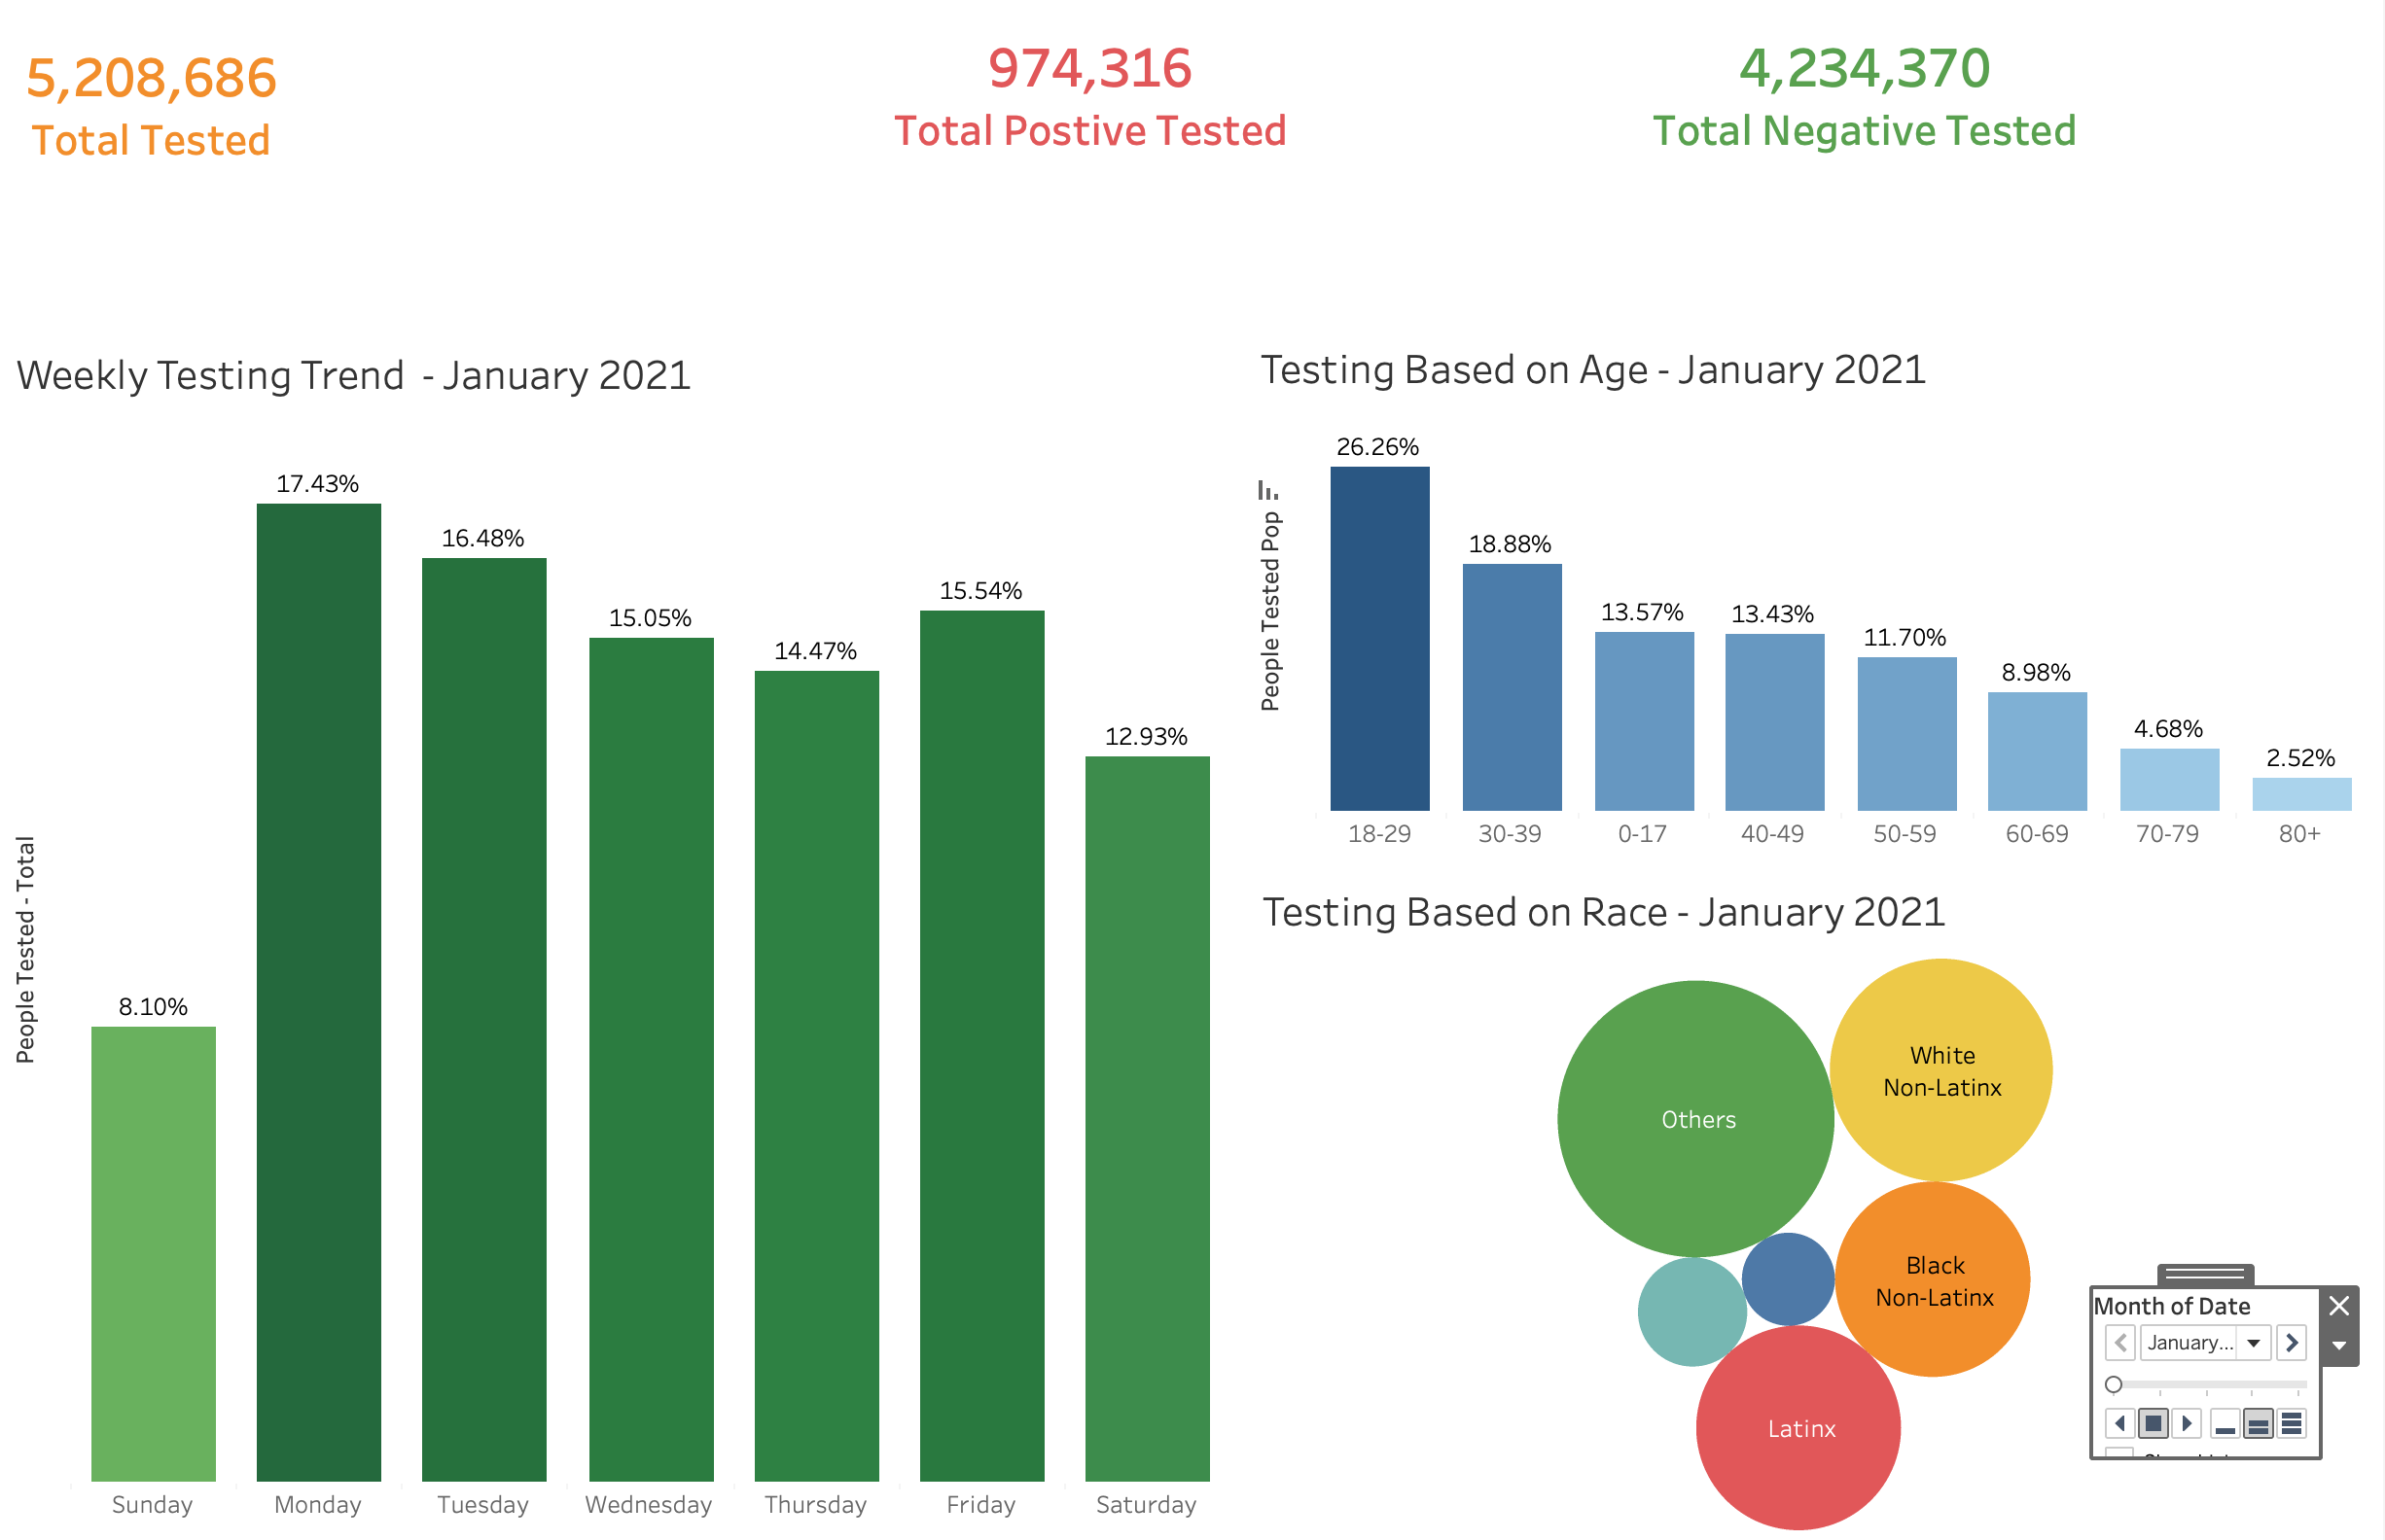
Group 1 Coronavirus disease (COVID-19) pandemic, Chicago Jan2020 to dec 2022 Hypothesis 2
Individuals aged between 18-29 showed the highest testing rates of 26.26%, with a statistically significant peak on Mondays with 17.43%

Slide 7

Group 1 Coronavirus disease (COVID-19) pandemic, Chicago Jan2020 to dec 2022 Hypothesis 2

Slide 8
Group 1 Coronavirus disease (COVID-19) pandemic,Chicago Jan2020 to dec 2022
Hypothesis 2 Insights
Testing by Age: Highest testing counts are among those aged 18-29, followed by 30-39, with significantly lower testing in older age groups.
Testing by Race: Variation in testing rates among racial groups suggests different levels of engagement or access to testing across racial demographics.
Weekly Testing Trend: Testing rates are highest on Monday (17.43%) and remain relatively high through Wednesday, with a notable dip on Sunday (8.10%), indicating increased testing at the start of the week.
Conclusion: Testing patterns are influenced by the day of the week, age demographics, and race, with higher engagement at the beginning of the week and among younger populations.

Slide 9
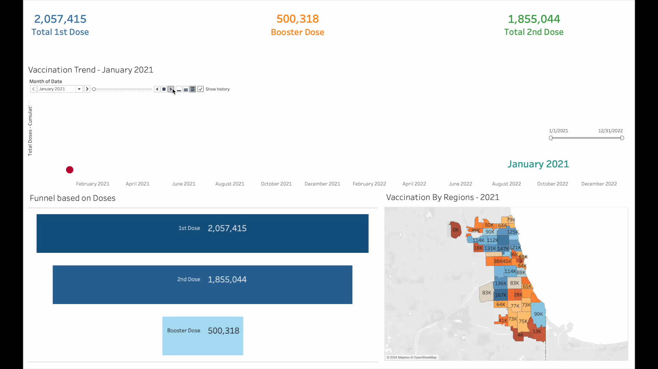
Group 1 Coronavirus disease (COVID-19) pandemic,Chicago Jan2020 to dec 2022 Hypothesis 3
Write

Slide 10
Group 1 Coronavirus disease (COVID-19) pandemic,Chicago Jan2020 to dec 2022
Hypothesis 3 Insights
Dose Funnel: Drop-off in uptake from the first dose to the second and booster doses highlights a decrease in vaccine engagement over time. Regional Variations: The vaccination map shows certain regions with higher vaccination rates than others, indicating possible disparities in access.
Vaccination Trend: The cumulative trend shows an initial surge in first doses, followed by slower increases in second and booster doses, suggesting challenges in sustaining vaccination rates.
Conclusion: The total vaccination in The city of Chicago in December 2022 recorded the highest number of doses administered because highest number of Testes has been conducted in that period.

Slide 11
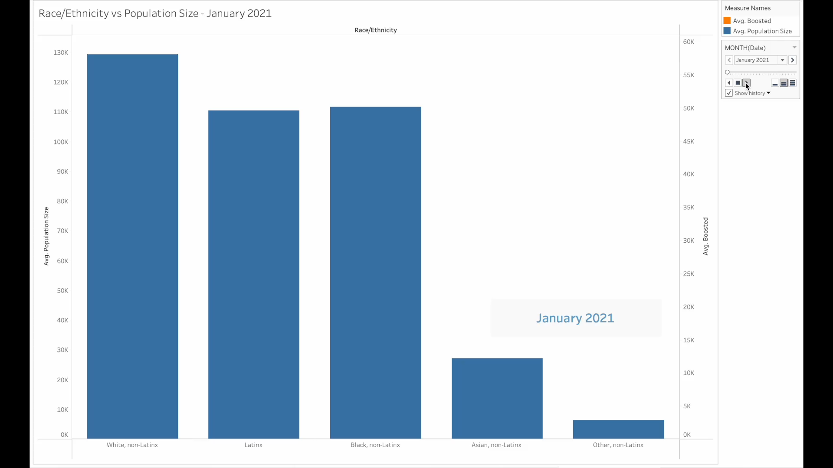
Group 1 Coronavirus disease (COVID-19) pandemic,Chicago Jan2020 to dec 2022 Hypothesis 4
Write

Slide 12
Group 1 Coronavirus disease (COVID-19) pandemic,Chicago Jan2020 to dec 2022
Hypothesis 4 Insights
We observed that Population vs. Booster Disparity: The chart indicates that the White non-Latinx group has the highest booster dose rate relative to their population size, while Latinx and Black non-Latinx populations show lower booster uptake. Asian non-Latinx and Other non-Latinx groups have relatively small population sizes and booster rates, indicating disparities in vaccine follow-through across racial groups.
Conclusion: Racial and Ethnic Disparities: Significant disparities exist in booster dose uptake across racial and ethnic groups, with the White non-Latinx population having higher booster rates, suggesting possible inequities in vaccine follow-through.

Slide 13
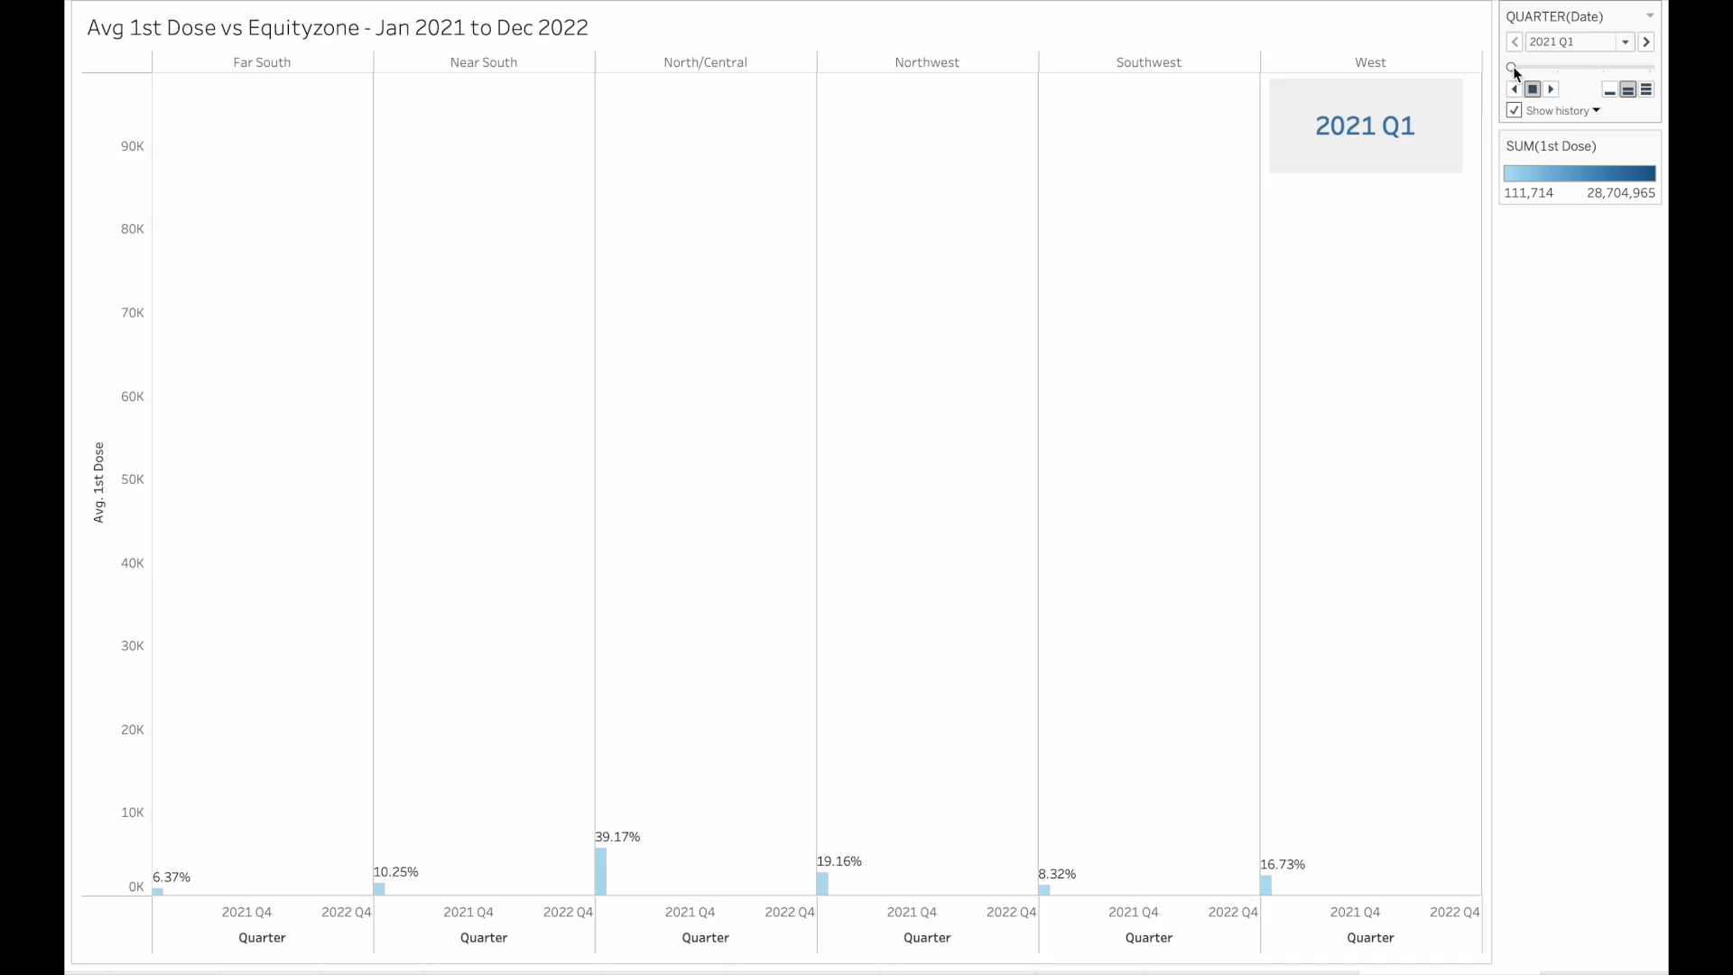
Group 1 Coronavirus disease (COVID-19) pandemic,Chicago Jan2020 to dec 2022 Hypothesis 5
Write

Slide 14
Group 1 Coronavirus disease (COVID-19) pandemic,Chicago Jan2020 to dec 2022
Hypothesis 5 Insights
We observed that Regional Variation in First Dose Uptake: Areas like the Near South and North/Central zones have higher first-dose averages, while regions like the Far South and Southwest show lower averages, indicating uneven distribution of initial vaccine doses across the city.
Conclusion: Geographic disparities in first-dose vaccination rates are evident across different equity zones, with some areas having significantly lower coverage.

Slide 15
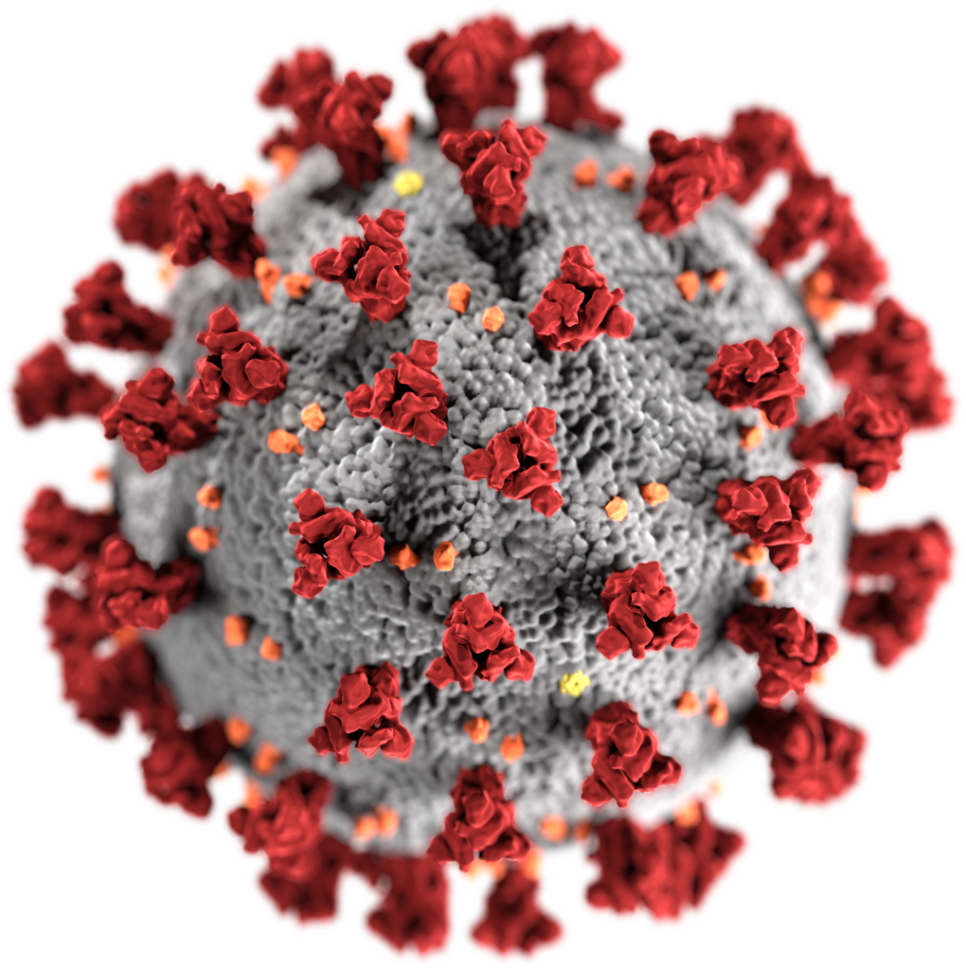
Group 1 Coronavirus disease (COVID-19) pandemic,Chicago Jan2020 to dec 2022
The Presentation & Proposal are based on True event & Dataset downloaded from https://catalog.data.gov/dataset/
Hypothesis is based upon the following common bullets.
Dataset : Covid 19 Pandemic (5 sets)
Location: Chicago
Duration: Jan 2020 to Dec 2022.
COVID - 19

Slide 16


Group 1 Coronavirus disease (COVID-19) pandemic,Chicago Jan2020 to dec 2022 about dataset & cleaning
The Presentation & Proposal are based on True event & Dataset downloaded from https://catalog.data.gov/dataset/
Dataset Preparation for data visualization
Purpose: Identify trends, comparisons, distributions among covid-19 Chicago’s dataset using different variables.
Data Collection: Gathered from data.gov all CSV files.
Data Cleaning
Removes duplicates
Handling missing values ( with the thumb rule of less then 2%)
Error correction
Deleting only Empty rows
Data Normalization
Data exploration
Data Insights
Data Visualization using Tableau
COVID-19_Vaccinations_by_Age_and_Race-Ethnicity_-_Historical.csv
COVID-19_Daily_Testing_-_By_Person_-_Historical.csv
COVID-19_Vaccinations_by_ZIP_Code_-_Historical.csv
COVID-19_Daily_Rolling_Average_Case__Death__and_Hospitalization_Rates_-_Historical.csv
COVID-19_-_Vaccinations_by_Region__Age__and_Race-Ethnicity_-_Historical.csv

Slide 17
Group 1 Coronavirus disease (COVID-19) pandemic, Chicago Jan2020 to dec 2022 about dataset & granularity
The Presentation & Proposal are based on True event & Dataset downloaded from https://catalog.data.gov/dataset/
COVID-19 Vaccinations by Age and Race-Ethnicity - Historical
Number of records [Row] : 5150
Number of Variable [Column] : 12
COVID-19 Daily Testing - By Person - Historical
Number of records [Row] : 127
Number of Variable [Column] : 59
COVID-19 Vaccinations by ZIP Code - Historical
Number of records [Row]: 43070
Number of Variable [Column] : 36
COVID-19 Daily Rolling Average Case, Death, and Hospitalization Rates - Historical
Number of records [Row]: 730
Number of Variable [Column] : 97
COVID-19 - Vaccinations by Region, Age, and Race-Ethnicity - Historical
Number of records [Row] : 5040
Number of Variable [Column] : 12

Slide 18
THANK YOU

